Slide 1

IPL Auction
SQL Project by: Disha D. Gupte

Slide 2
Importing data
create table ipl_ball1(
id int, inning int, over int, ball int,
batsman varchar,non_striker varchar, bowler varchar,
batsman_runs int, extra_runs int, total_runs int,
is_wicket int,dismissal_type varchar,player_dismissed varchar,
fielder varchar,extra_type varchar,batting_team varchar,bowling_team varchar);
select * from ipl_ball1;
copy ipl_ball1 from 'C:\Program Files\PostgreSQL\16\Data\IPL Dataset\IPL_ball1.csv' delimiter ',' csv header;

Slide 3
create table ipl_matches1(
id int, city varchar, mdate date,
player_of_match varchar,venue varchar, neutral_venue varchar,
team1 varchar, team2 varchar, toss_winner varchar,
toss_decision varchar,winner varchar,mresult varchar,
result_margin int,eliminator varchar,emethod varchar,umpire1 varchar,umpire2 varchar);
copy ipl_matches1 from 'C:\Program Files\PostgreSQL\16\Data\IPL Dataset\IPL_matches1.csv' delimiter ',' csv header;

Slide 4
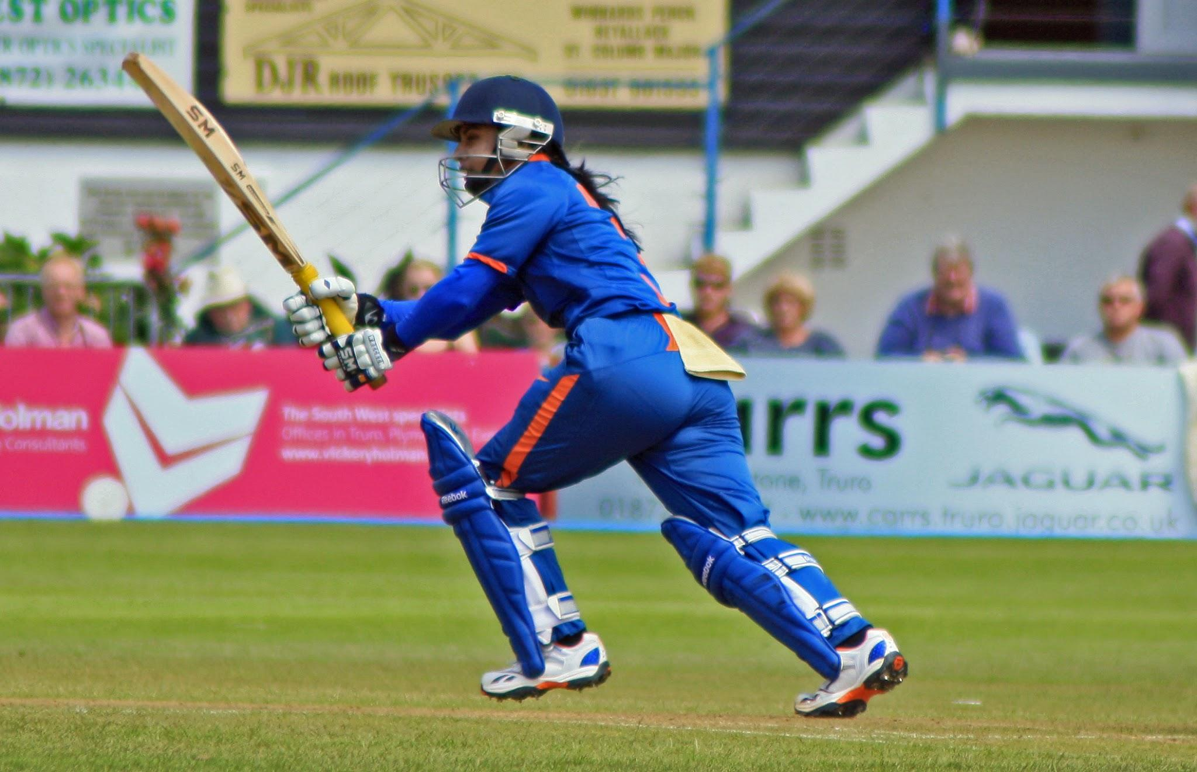
Bidding on Batters

Slide 5
Aggressive Batsmen:
select batsman,sum(total_runs) as runs,sum(ball) as balls,
(sum(total_runs)/sum(ball))*100 as Strike_Rate
from ipl_ball1
where extra_type not like 'wides'
group by batsman having sum(ball)>500
order by Strike_Rate desc limit 10;

Slide 6
Table output
"batsman" "runs" "balls" "strike_rate"
"AD Russell" 1544 3231 47.78706282884556
"SP Narine" 921 1948 47.27926078028747
"MM Ali" 320 694 46.10951008645533
"BCJ Cutting" 242 532 45.48872180451128
"N Pooran" 531 1197 44.3609022556391
"V Sehwag" 2819 6386 44.14343877231444
"HH Pandya" 1378 3143 43.8434616608336
"GJ Maxwell" 1554 3575 43.46853146853147
"CH Gayle" 4912 11501 42.709329623511
"AB de Villiers" 4930 11569 42.61388192583629

Slide 7
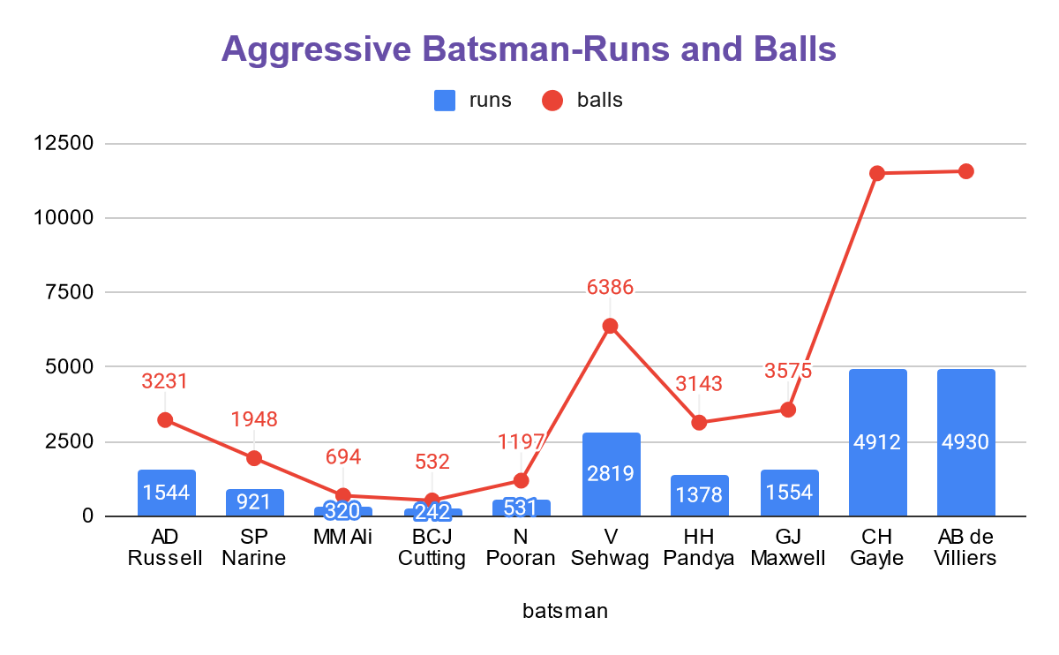

Slide 8
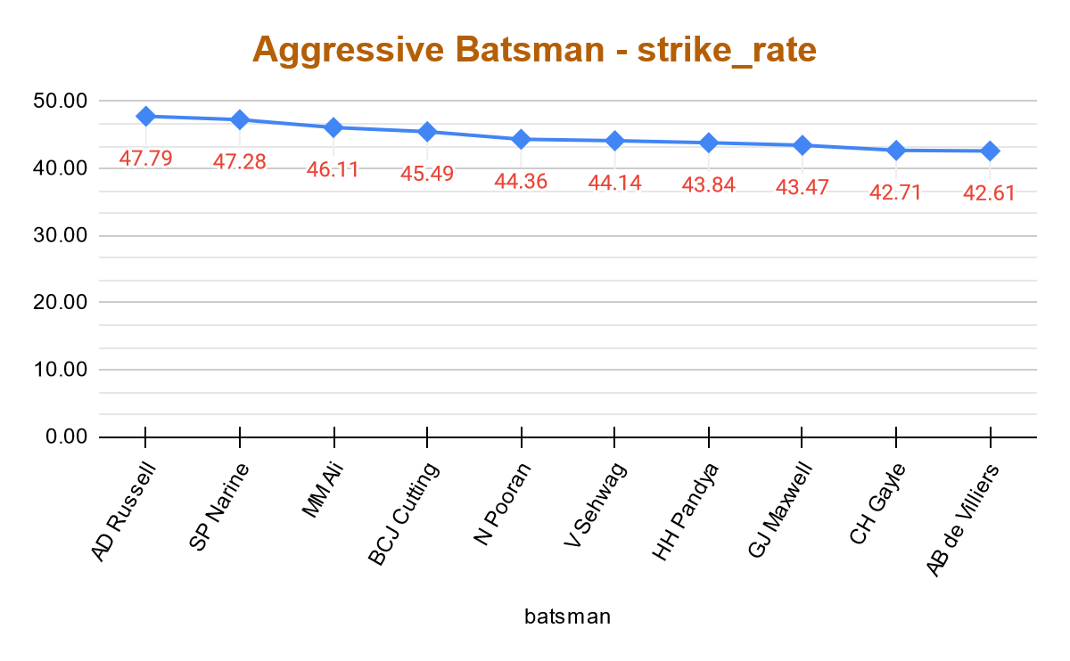
Visualization

Slide 9
Anchor Batsmen
select a.batsman,sum(total_runs) as runs,count(is_wicket=1) as dismissal_count,
(sum(total_runs)/count(is_wicket=1)) as Average,b.total_seasons_played, case when b.total_seasons_played > 2 then
'Atleast Played 2 Seasons' end as seasons_played
from ipl_ball1 as a
Left join seasons_played as b on a.batsman=b.batsman
group by a.batsman, b.total_seasons_played order by total_seasons_played desc limit 10;
create view avg_batsman as
SELECT ipl_ball1.batsman, extract(year from ipl_matches1.mdate) as season,
count(distinct extract(year from ipl_matches1.mdate)) as seasons_played
FROM ipl_ball1
join ipl_matches1 on ipl_ball1.id=ipl_matches1.id
group by ipl_ball1.batsman,extract(year from ipl_matches1.mdate)
order by ipl_ball1.batsman,season
--IPL seasons played by each batsman
create view seasons_played as
select batsman,sum(seasons_played) as total_seasons_played from avg_batsman
group by batsman order by total_seasons_played desc
select * from seasons_played

Slide 10
Table output
"batsman" "runs" "dismissal_count" "average" "total_seasons_played" "seasons_played"
"AB de Villiers" 5016 3264 1.536764705882353 13 "Atleast Played 2 Seasons"
"KD Karthik" 3996 3023 1.3218656963281508 13 "Atleast Played 2 Seasons"
"MK Pandey" 3418 2772 1.233044733044733 13 "Atleast Played 2 Seasons"
"MS Dhoni" 4855 3493 1.389922702547953 13 "Atleast Played 2 Seasons"
"RG Sharma" 5394 4088 1.3194716242661448 13 "Atleast Played 2 Seasons"
"RV Uthappa" 4878 3658 1.333515582285402 13 "Atleast Played 2 Seasons"
"S Dhawan" 5452 4208 1.2956273764258555 13 "Atleast Played 2 Seasons"
"V Kohli" 6081 4609 1.3193751356042525 13 "Atleast Played 2 Seasons"
"WP Saha" 2074 1541 1.345879299156392 13 "Atleast Played 2 Seasons"
"A Mishra" 402 410 0.9804878048780488 12 "Atleast Played 2 Seasons"

Slide 11
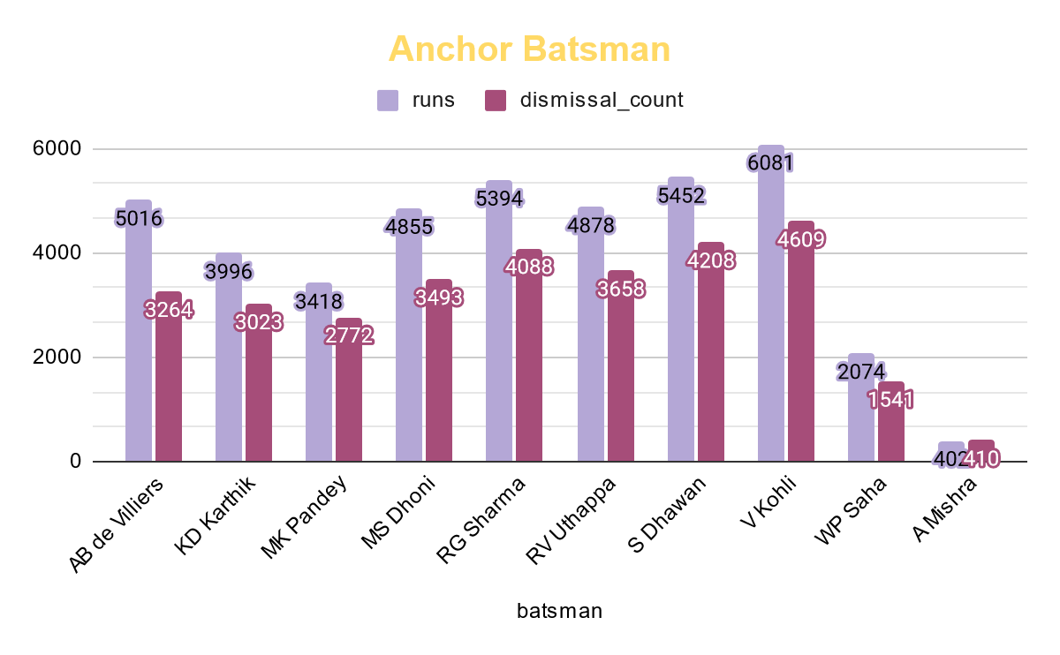
Visualization

Slide 12
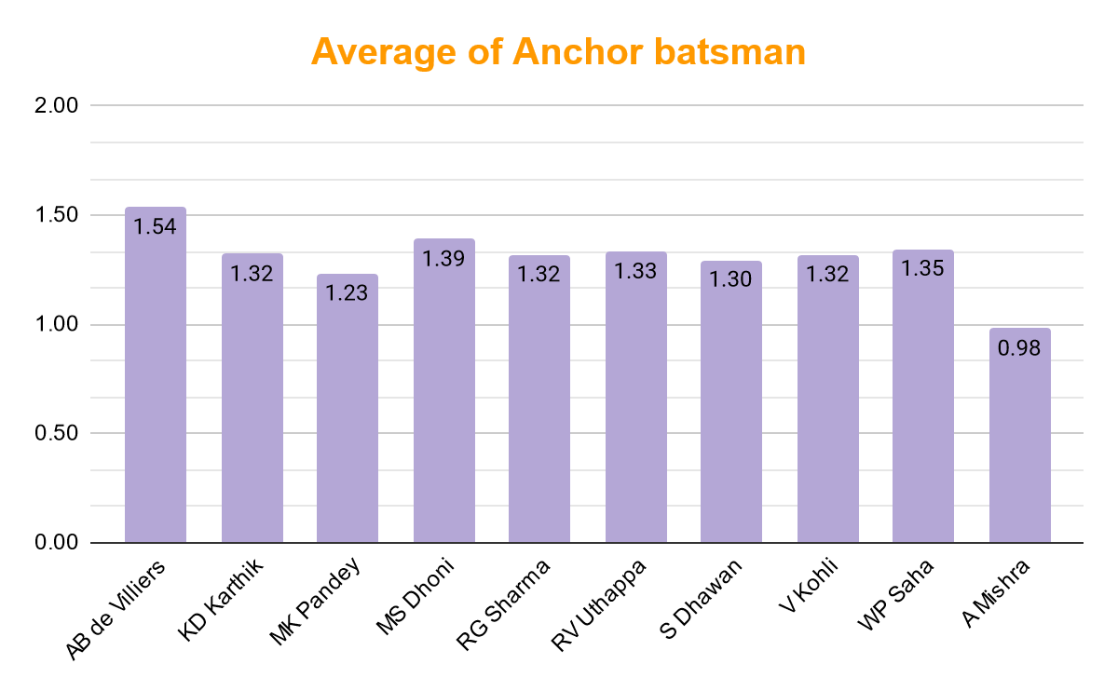

Slide 13
Hard Hitters
select batsman, count(batsman_runs) as hits, sum(batsman_runs) as boundry_runs,sum(total_runs) as total_runs,
(sum(batsman_runs)/sum(total_runs))*100 as boundry_percent
from ipl_ball1
where batsman_runs in (4,6)
group by batsman order by boundry_runs desc;

Slide 14
Table output
"batsman" "hits" "boundry_runs" "total_runs" "boundry_percent"
"CH Gayle" 733 3630 3636 99.83498349834984
"V Kohli" 706 3228 3229 99.96903065964695
"DA Warner" 705 3210 3215 99.84447900466563
"SK Raina" 687 3136 3139 99.90442816183499
"RG Sharma" 672 3116 3121 99.83979493752003
"S Dhawan" 700 3018 3023 99.83460138934834
"AB de Villiers" 625 2970 2975 99.83193277310924
"RV Uthappa" 617 2794 2795 99.96422182468694
"SR Watson" 566 2644 2647 99.88666414809218
"MS Dhoni" 529 2548 2550 99.92156862745098

Slide 15
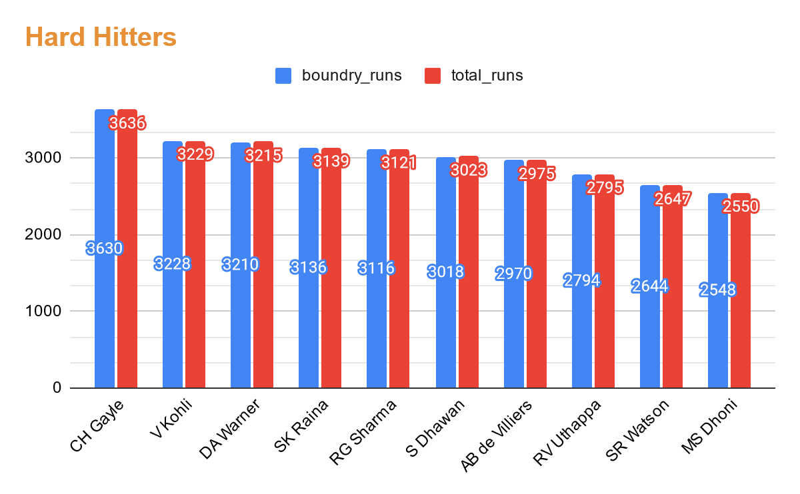
Visualization

Slide 16
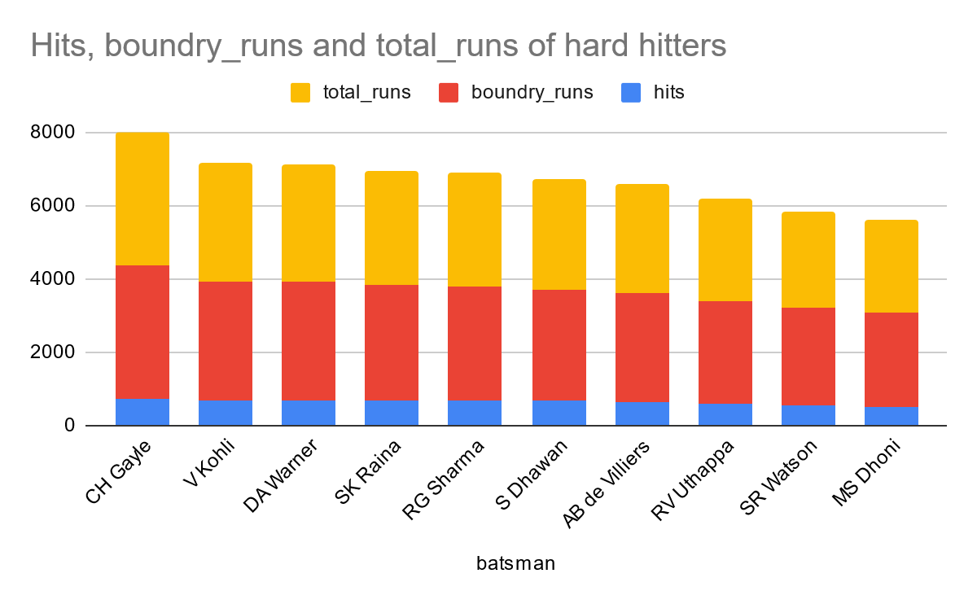

Slide 17

Bidding on bowlers

Slide 18
Economical Bowlers
select bowler,sum(ball) as total_balls, floor(sum(ball)/6) as total_overs,sum(total_runs) as conceded_runs,
(floor(sum(ball)/6) /sum(total_runs))*100 as economy_rate
from ipl_ball1
group by bowler having sum(ball) > 500
order by economy_rate limit 10;

Slide 19
Table output
"bowler" "total_balls" "total_overs" "conceded_runs" "economy_rate"
"TK Curran" 663 110 328 33.53658536585366
"Avesh Khan" 665 110 301 36.544850498338874
"R Sathish" 520 86 233 36.9098712446352
"Basil Thampi" 1561 260 704 36.93181818181818
"CJ Anderson" 1169 194 525 36.952380952380956
"JDS Neesham" 547 91 245 37.142857142857146
"S Ladda" 504 84 225 37.333333333333336
"KC Cariappa" 812 135 349 38.68194842406877
"I Udana" 667 111 286 38.81118881118881
"MP Stoinis" 2033 338 869 38.89528193325661

Slide 20
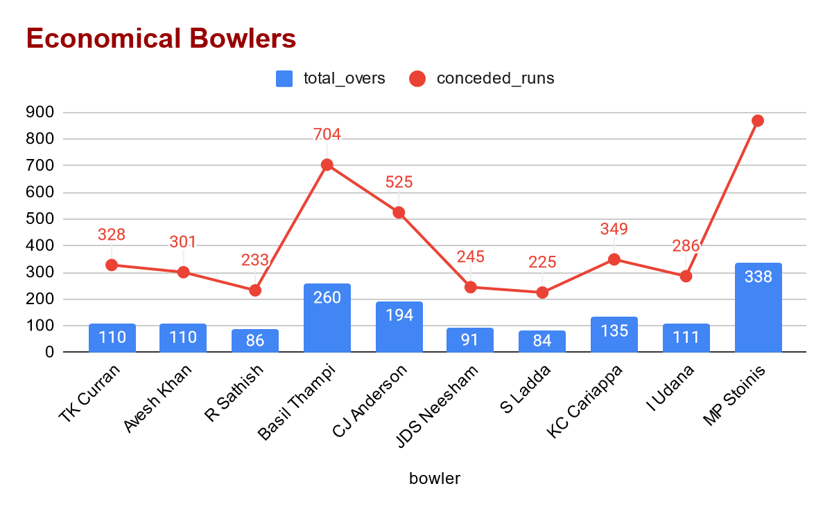
Visualization

Slide 21
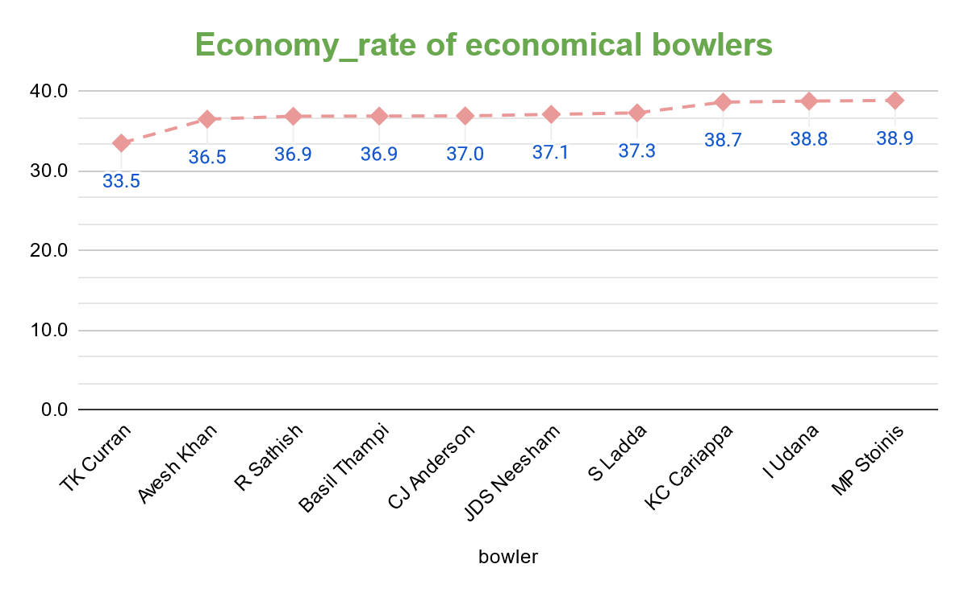

Slide 22
Wicket-taking bowlers
select bowler,sum(ball) as total_balls, count(is_wicket=1) as wickets_taken,
(sum(ball)/count(is_wicket=1)) as strike_rate
from ipl_ball1
group by bowler having sum(ball) > 500
order by strike_rate limit 10 ;

Slide 23
Table output
"bowler" "total_balls" "wickets_taken" "strike_rate"
"A Chandila" 819 234 3.5
"Mohammad Nabi" 1040 297 3.5016835016835017
"IS Sodhi" 638 182 3.5054945054945055
"CV Varun" 1162 331 3.510574018126888
"S Lamichhane" 742 211 3.5165876777251186
"R Sharma" 3293 935 3.5219251336898396
"DL Vettori" 2765 785 3.522292993630573
"PP Chawla" 11594 3285 3.5293759512937597
"PC Valthaty" 540 153 3.5294117647058822
"KV Sharma" 4373 1239 3.5294592413236483

Slide 24
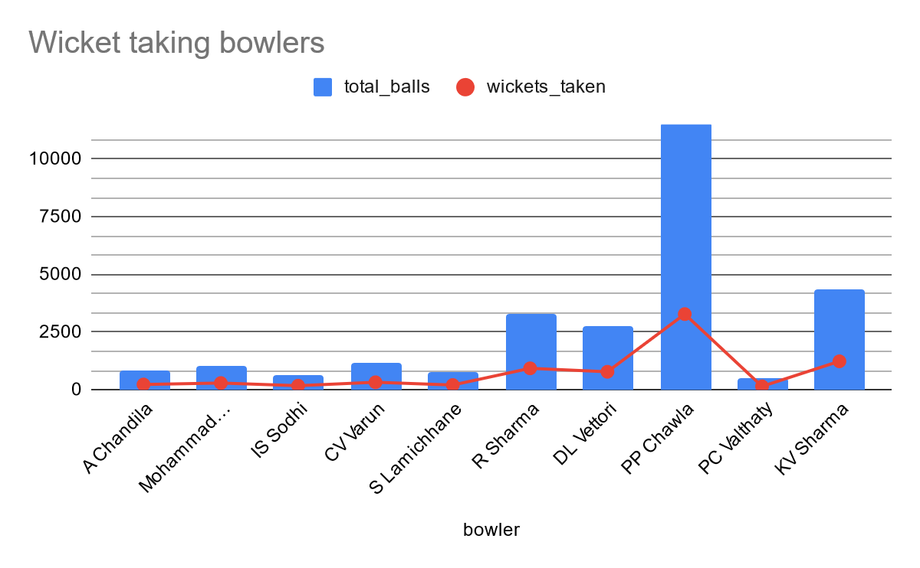
Visualization

Slide 25
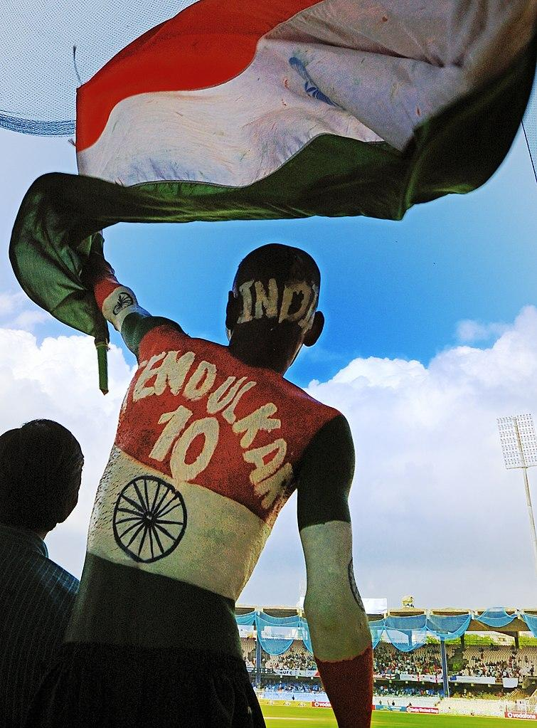
All rounders
Bidding on
all rounders

Slide 26
All rounders
select batsman,(sum(ball)/count(is_wicket=1)) as bowler_strike_rate,
(sum(total_runs)/sum(ball))*100 as batsman_strike_rate
from ipl_ball1
group by batsman having sum(ball) > 500
union
select bowler,(sum(ball)/count(is_wicket=1)) as bowler_strike_rate,
(sum(total_runs)/sum(ball))*100 as batsman_strike_rate
from ipl_ball1
group by bowler having sum(ball) > 300
order by bowler_strike_rate limit 10

Slide 27
Table output
"batsman" "bowler_strike_rate" "batsman_strike_rate"
"PP Shaw" 3.330578512396694 42.18362282878412
"Salman Butt" 3.3372093023255816 36.7595818815331
"Shubman Gill" 3.3511749347258486 37.670432411375145
"RD Gaikwad" 3.3583815028901736 37.8657487091222
"JEC Franklin" 3.365695792880259 32.88461538461539
"RS Bopara" 3.378205128205128 35.23086654016445
"R Sathish" 3.402542372881356 35.865504358655045
"MJ Guptill" 3.4183673469387754 41.04477611940299
"AM Rahane" 3.4457142857142857 35.82089552238806
"JR Hopes" 3.445859872611465 40.0184842883549

Slide 28
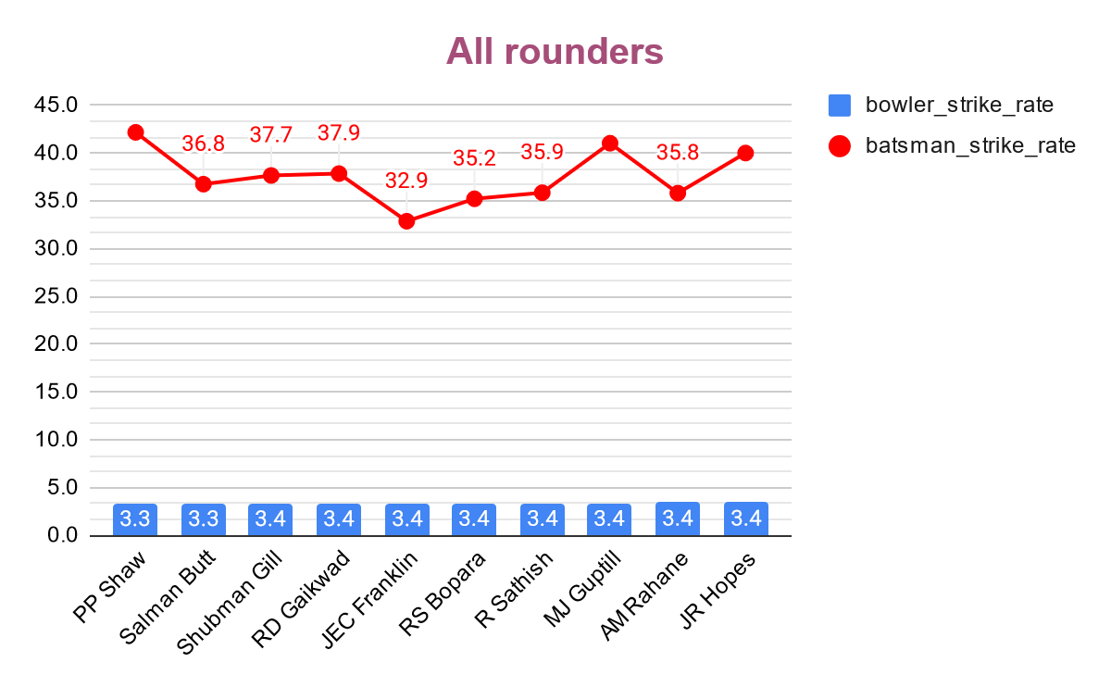
Visualization

Slide 29
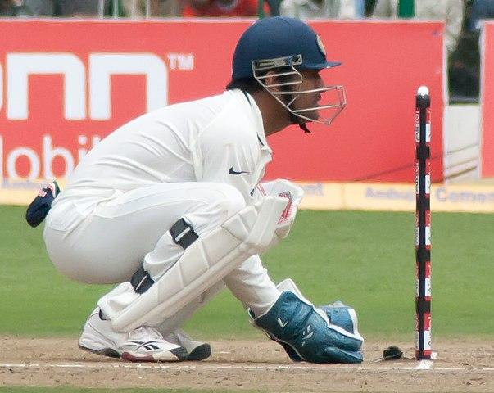
Choosing Wicket keepers

Slide 30
As we know the main role of wicket keeper , who is the player on the fielding side who stands behind the wicket or stumps being watchful of the batsman and ready to take a catch, stump the batsman out and run out a batsman when occasion arises. So we should choose the wicket keeper very properly.
The criteria would be:
The player must have played at least 2 IPL seasons as wicket-keeper.
The dismissal_kind,fielder columns from IPL_ball table can be targeted. We can count the dissmissal_kind of batsman is stumped or run out for particular fielder. More the count more eligible is the fielder for wicketkeeping. Also the fielder must have at least bowled 200 balls and faced 300 balls.
As sometimes the wicket keeper also have to bowl or many time he/she has to bat according to batting line.

Slide 31
Final Assessment Questions

Slide 32
--1– Please note my ipl_matches1 is ‘matches’ table & ipl_ball1 is ‘deliveries table
select city,count(city) as host_city from ipl_matches1
group by city order by host_city desc;
--2
create table deliveries_v02 as
select *, case
when total_runs >=4
then 'Boundary'
when total_runs = 0
then 'Dot ball'
else 'other'
end as ball_result from ipl_ball1;

Slide 33
--3
select count(ball_result)||' are total number of Boundaries' as Total_boundry_Dot_balls from deliveries_v02
where ball_result like '%Boundary'
union
select count(ball_result)||' are total number of Dot balls' from deliveries_v02
where ball_result like '%Dot ball'
--4
select batting_team, count(ball_result)as Number_of_boundries from deliveries_v02
where ball_result like '%Boundary'
group by batting_team order by Number_of_boundries desc;

Slide 34
--5
select bowling_team, count(ball_result)as Number_of_dot_balls from deliveries_v02
where ball_result like '%Dot ball'
group by bowling_team order by Number_of_dot_balls desc;
--6
select count(dismissal_type)as Number_of_dismissals from deliveries_v02
where dismissal_type not like '%NA'
--7
select bowler,count(extra_runs) as Extra_runs_conceded from ipl_ball1
group by bowler order by Extra_runs_conceded limit 5;

Slide 35
--8
create table deliveries_v03 as
select a.*,b.venue,b.mdate
from deliveries_v02 as a
left join ipl_matches1 as b
on a.id=b.id;
--9
select venue,sum(total_runs) as Total_runs_scored from deliveries_v03
group by venue order by Total_runs_scored desc;
--10
select distinct extract(year from mdate) as Match_year,sum(total_runs) as Total_runs_scored from deliveries_v03
where venue ='Eden Gardens'
group by distinct extract(year from mdate) order by Total_runs_scored desc;

Slide 36

Great team selected !!!

Slide 37


